Slide 1
Formal Methods in Software Engineering

Slide 2
Set Theory and Set operations

Slide 3
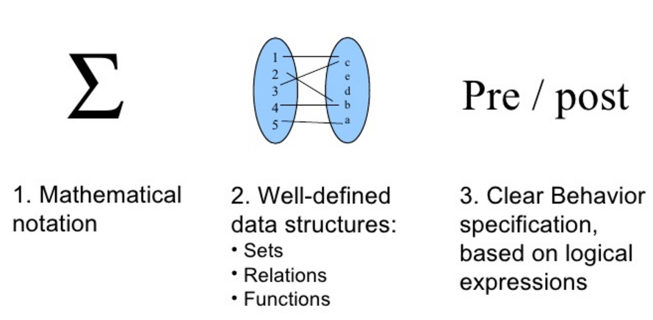
Formal Specification Methods

Slide 4
Set
A set is a group of “objects”
  Rainbow Colors: { red, orange, yellow, green, blue, indigo, violet }
  Pakistani Cities: { Islamabad, Lahore, Karachi, Peshawar, Quetta … }
Sets are notated with curly brackets
Sets do not have duplicate elements
  Consider the set of vowels in the alphabet.
    It makes no sense to list them as {a, a, a, e, i, o, o, o, o, o, u}
    What we really want is just {a, e, i, o, u}
Multiset is a group that takes into account number of occurrences of members.
  {7} and {7, 7} are different as multisets but identical as sets.
Order does not matter
  We often write them in order because it is easier for humans to understand it that way
  {1, 2, 3, 4, 5} is equivalent to {3, 5, 2, 4, 1}

Slide 5
Specifying a Set – I
Sets are usually represented by a capital letter (A, B, S, etc.)
Elements are usually represented by an italic lower-case letter (a, x, y, etc.)
Easiest way to specify a set is to list all the elements: A = {1, 2, 3, 4, 5}
  Not always feasible for large or infinite sets
Can use an ellipsis (…): B = {0, 1, 2, 3, …}
  Can cause confusion. Consider the set C = {3, 5, 7, …}. What comes next?
  If the set is all odd integers greater than 2, it is 9
  If the set is all prime numbers greater than 2, it is 11

Slide 6
Specifying a Set – II
Can use set-builder notation
  D = {x | x is prime and x > 2}
  E = {x | x is odd and x > 2}
  The vertical bar means “such that”
  Thus, set D is read (in English) as: “all elements x such that x is prime and x is greater than 2”
A set is said to “contain” the various “members” or “elements” that make up the set
  If an element a is a member of (or an element of) a set S, we use then notation a ∈ S
    4 ∈ {1, 2, 3, 4}
  If an element is not a member of (or an element of) a set S, we use the notation a ∉ S
    7 ∉ {1, 2, 3, 4}
    London ∉ {1, 2, 3, 4}

Slide 7
Often used Sets
N = {0, 1, 2, 3, …} is the set of natural numbers
Z = {…, -2, -1, 0, 1, 2, …} is the set of integers
Z⁺ = {1, 2, 3, …} is the set of positive integers (a.k.a whole numbers)
  Note that people disagree on the exact definitions of whole numbers and natural numbers
Q = {p/q | p ∈ Z, q ∈ Z, q ≠ 0} is the set of rational numbers
  Any number that can be expressed as a fraction of two integers (where the bottom one is not zero)
R is the set of real numbers

Slide 8
The Universal Set
U is the universal set – the set of all of elements (or the “universe”) from which given any set is drawn
  For the set {-2, 0.4, 2}, U would be the real numbers
  For the set {0, 1, 2}, U could be the natural numbers (zero and up), the integers, the rational numbers, or the real numbers, depending on the context
For the set of the students in this class, U would be all the students in the University (or perhaps all the people in the world)
For the set of the vowels of the alphabet, U would be all the letters of the alphabet
To differentiate U from U (which is a set operation), the universal set is written in a different font (and in bold and italics)

Slide 9
Venn diagrams
Represents sets graphically
  The box represents the universal set
  Circles represent the set(s)
Consider set S, which is
the set of all vowels in the
alphabet
The individual elements
are usually not written
in a Venn diagram
b
c
d
f
U
g
h
j
S
k
l
m
n
p
q
a
e
i
r
s
t
o
u
v
w
x
y
z

Slide 10
The Empty Set
If a set has zero elements, it is called the empty (or null) set
  Written using the symbol ∅
  Thus, ∅ = { } ← VERY IMPORTANT
  If you get confused about the empty set in a problem, try replacing ∅ by { }
As the empty set is a set, it can be an element of other sets
  { ∅, 1, 2, 3, x } is a valid set
Note that ∅ ≠ { ∅ }
  The first is a set of zero elements
  The second is a set of 1 element (that one element being the empty set)

Slide 11
Set Equality
Two sets are equal if they have the same elements
  {1, 2, 3, 4, 5} = {5, 4, 3, 2, 1}
  {1, 2, 3, 2, 4, 3, 2, 1} = {4, 3, 2, 1}
Two sets are not equal if they do not have the same elements
  {1, 2, 3, 4, 5} ≠ {1, 2, 3, 4}

Slide 12
Subsets
If all the elements of a set S are also elements of a set T, then S is a subset of T
  For example, if S = {2, 4, 6} and T = {1, 2, 3, 4, 5, 6, 7}, then S is a subset of T
  This is specified by S ⊆ T OR {2, 4, 6} ⊆ {1, 2, 3, 4, 5, 6, 7}
If S is not a subset of T, it is written as: S ⊆ T
  For example, {1, 2, 8} ⊆ {1, 2, 3, 4, 5, 6, 7}
Note that any set is a subset of itself!
  Given set S = {2, 4, 6}, since all the elements of S are elements of S, S is a subset of itself
  This is kind of like saying 5 is less than or equal to 5
  Thus, for any set S, S ⊆ S

Slide 13
Proper Subsets
If S is a subset of T, and S is not equal to T, then S is a proper subset of T
  Let T = {0, 1, 2, 3, 4, 5}
  If S = {1, 2, 3}, S is not equal to T, and S is a subset of T
  A proper subset is written as S ⊂ T
  Let R = {0, 1, 2, 3, 4, 5}. R is equal to T, and thus is a subset (but not a proper subset) of T
    Can be written as: R ⊆ T and R ⊄ T (or just R = T)
  Let Q = {4, 5, 6}. Q is neither a subset of T nor a proper subset of T
The difference between “subset” and “proper subset” is like the difference between “less than or equal to” and “less than” for numbers
The empty set is a proper subset of all sets other than the empty set (as it is equal to the empty set)

Slide 14
Proper Subsets: Venn diagram
S ⊂ R
U
R
S

Slide 15
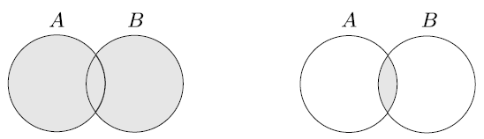
Union
Intersection
A = {1, 2, 3}
B = {3, 4, 5}
A U B = {1, 2, 3, 4, 5}
A = {1, 2, 3}
B = {3, 4, 5}
A ∩ B = {3}

Slide 16
Sequence
List of objects in some order, usually written within parentheses
(7, 21, 57) is not the same as (57, 7, 21)
Repetition does matter in a sequence
Finite sequences are often called tuples
A sequence with k elements is a k-tuple. Example: (7,21,57) is a 3-tuple
A 2-tuple is also called an ordered pair
Sets and sequences may appear as elements of other sets and sequences

Slide 17
Cartesian Product or Cross Product
If A and B are two sets, then their Cartesian Product, A x B, is the set of all ordered pairs wherein the first element is a member of A and the second element is a member of B
If A = {1, 2} and B = {x, y, z},
A x B = {(1,x), (1,y), (1,z), (2,x), (2,y), (2,z)}

Slide 18
Functions and Relations

Slide 19
Introduction
The relation shows the relationship between INPUT and OUTPUT.
A function is a relation which derives one OUTPUT for each given INPUT.

Slide 20
What is the Relation?
It is a subset of the Cartesian product. Or simply, a bunch of points (ordered pairs). In other words, the relation between the two sets is defined as the collection of the ordered pair, in which the ordered pair is formed by the object from each set.
Example: {(-2, 1), (4, 3), (7, -3)}, usually written in set notation form with curly brackets.

Slide 21
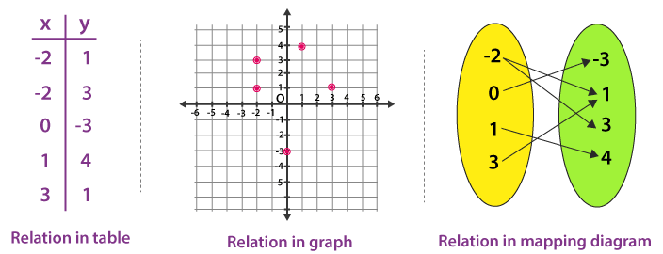
Relation Representation
There are other ways too to write the relation, apart from set notation such as through tables, plotting it on XY- axis or through mapping diagram.

Slide 22
Domain
&
Range
Domain | It is a collection of the first values in the ordered pair (Set of all input (x) values).
Range | It is a collection of the second values in the ordered pair (Set of all output (y) values).

Slide 23
Example:
In the relation, {(-2, 3), {4, 5), (6, -5), (-2, 3)},
The domain is {-2, 4, 6}
Range is {-5, 3, 5}
Note: Don’t consider duplicates while writing the domain and range and also write it in increasing order.

Slide 24
What is a Function?
A function is a relation which describes that there should be only one output for each input (or) we can say that a special kind of relation (a set of ordered pairs), which follows a rule i.e every X-value should be associated with only one y-value is called a function.

Slide 25
For example
Domain | Range
-1 | -3
1 | 3
3 | 9

Slide 26
Function
An object that sets up an input-output relationship by taking an input and producing an output. ƒ(a) = b
A mapping that maps a to b
Domain : Set of possible inputs to the function
Range : Set of possible outputs of a function
A function with domain D and range R is:
ƒ : D → R
Function with a single argument is Unary Function
Function with a two arguments is Binary Function
Predicate or Property is a function whose range is {TRUE, FALSE}

Slide 27
Consider the function ƒ : {1, 2,3,4,5} → {1, 4,9,16,25}.
n | ƒ(n)
1 | 1
2 | 4
3 | 9
4 | 16
5 | 25
This function takes square of input values and produce corresponding output.

Slide 28
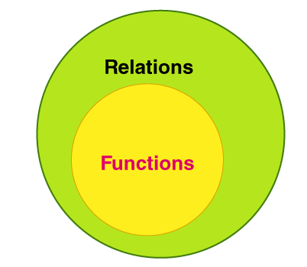
All functions are relations, but not all relations are functions.

Slide 29
Types of Functions
One to one function or Injective function: A function f: P → Q is said to be one to one if for each element of P there is a distinct element of Q.
Many to one function: A function which maps two or more elements of P to the same element of set Q.
Onto Function or Surjective function: A function for which every element of set Q there is pre-image in set P
One-one correspondence or Bijective function: The function f matches with each element of P with a discrete element of Q and every element of Q has a pre-image in P.

Slide 30
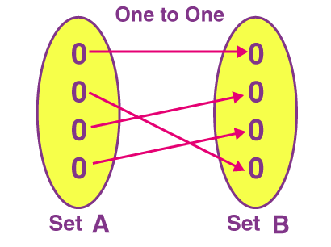
One-to-One Functions
A function has many types, and one of the most common functions used is the one-to-one function or injective function.

Slide 31
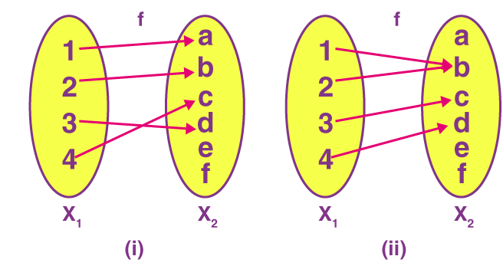
The below figure shows two functions, where (i) is the injective (one to one) function and (ii) is not an injective, i.e. many-one function.

Slide 32
Onto Function
Onto function could be explained by considering two sets, Set A and Set B, which consist of elements. If for every element of B, there is at least one or more than one element matching with A, then the function is said to be onto function or surjective function.

Slide 33
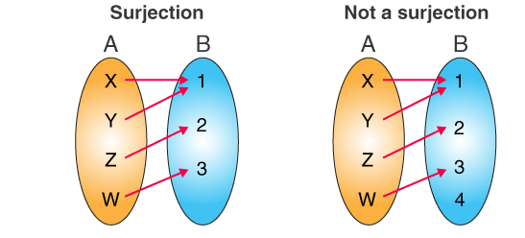
Example

Slide 34
Bijective Function
A function is said to be bijective or bijection, if a function f: A → B satisfies both the injective (one-to-one function) and surjective function (onto function) properties. It means that every element “b” in the codomain B, there is exactly one element “a” in the domain A. such that f(a) = b. If the function satisfies this condition, then it is known as one-to-one correspondence

Slide 35
What Is Type of the Function?
a
1
b
2
c
3
4
One-to-One but not Onto

Slide 36
What Is Type of the Function?
a
1
b
2
c
3
d
Onto but not One-to-One

Slide 37
What Is Type of the Function?
a
1
b
2
c
3
d
4
Onto and One-to-One

Slide 38
What Is Type of the Function?
a
1
b
2
c
3
d
4
Neither One-to-One nor Onto

Slide 39
What Is Type of the Function?
a
1
b
2
c
3
4
Not a function

Slide 40
Bijective Function Properties
each element of A must be paired with at least one element of B,
no element of A may be paired with more than one element of B,
each element of B must be paired with at least one element of A, and
no element of B may be paired with more than one element of A.

Slide 41
Partial function
A partial function f: A ⇸ B, is a subset of A*B with property that for each a∈A, there is at most one b∈B with (a,b) ∈f.

Slide 42
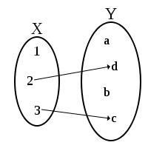
An example of a partial function that is injective.

Slide 43
Total Function
A total function is denoted by f : A → B, provided that it is
A) partial function
B) dom f=A

Slide 44
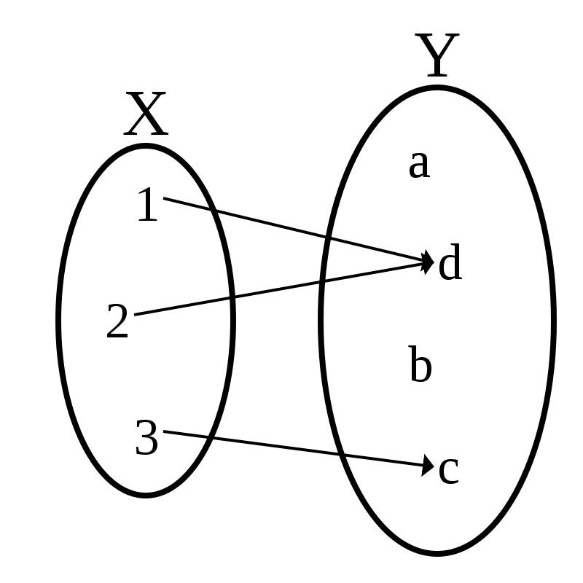
An example of a total function that is not injective.

